Slide 1

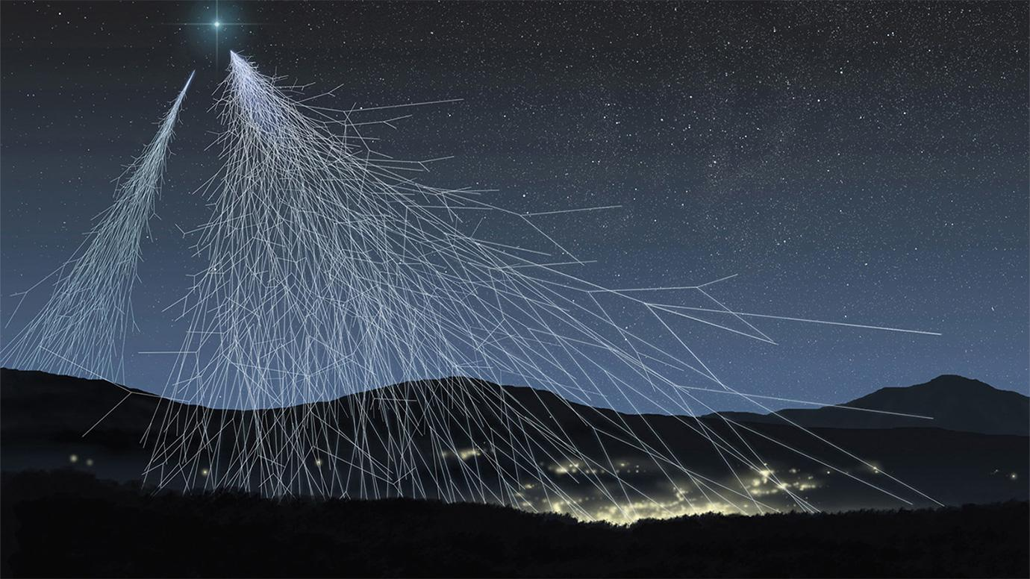
Anisotropy on Cosmic Rays: χ^2
05/07/2025 Updates
Andrés Marín

Slide 2
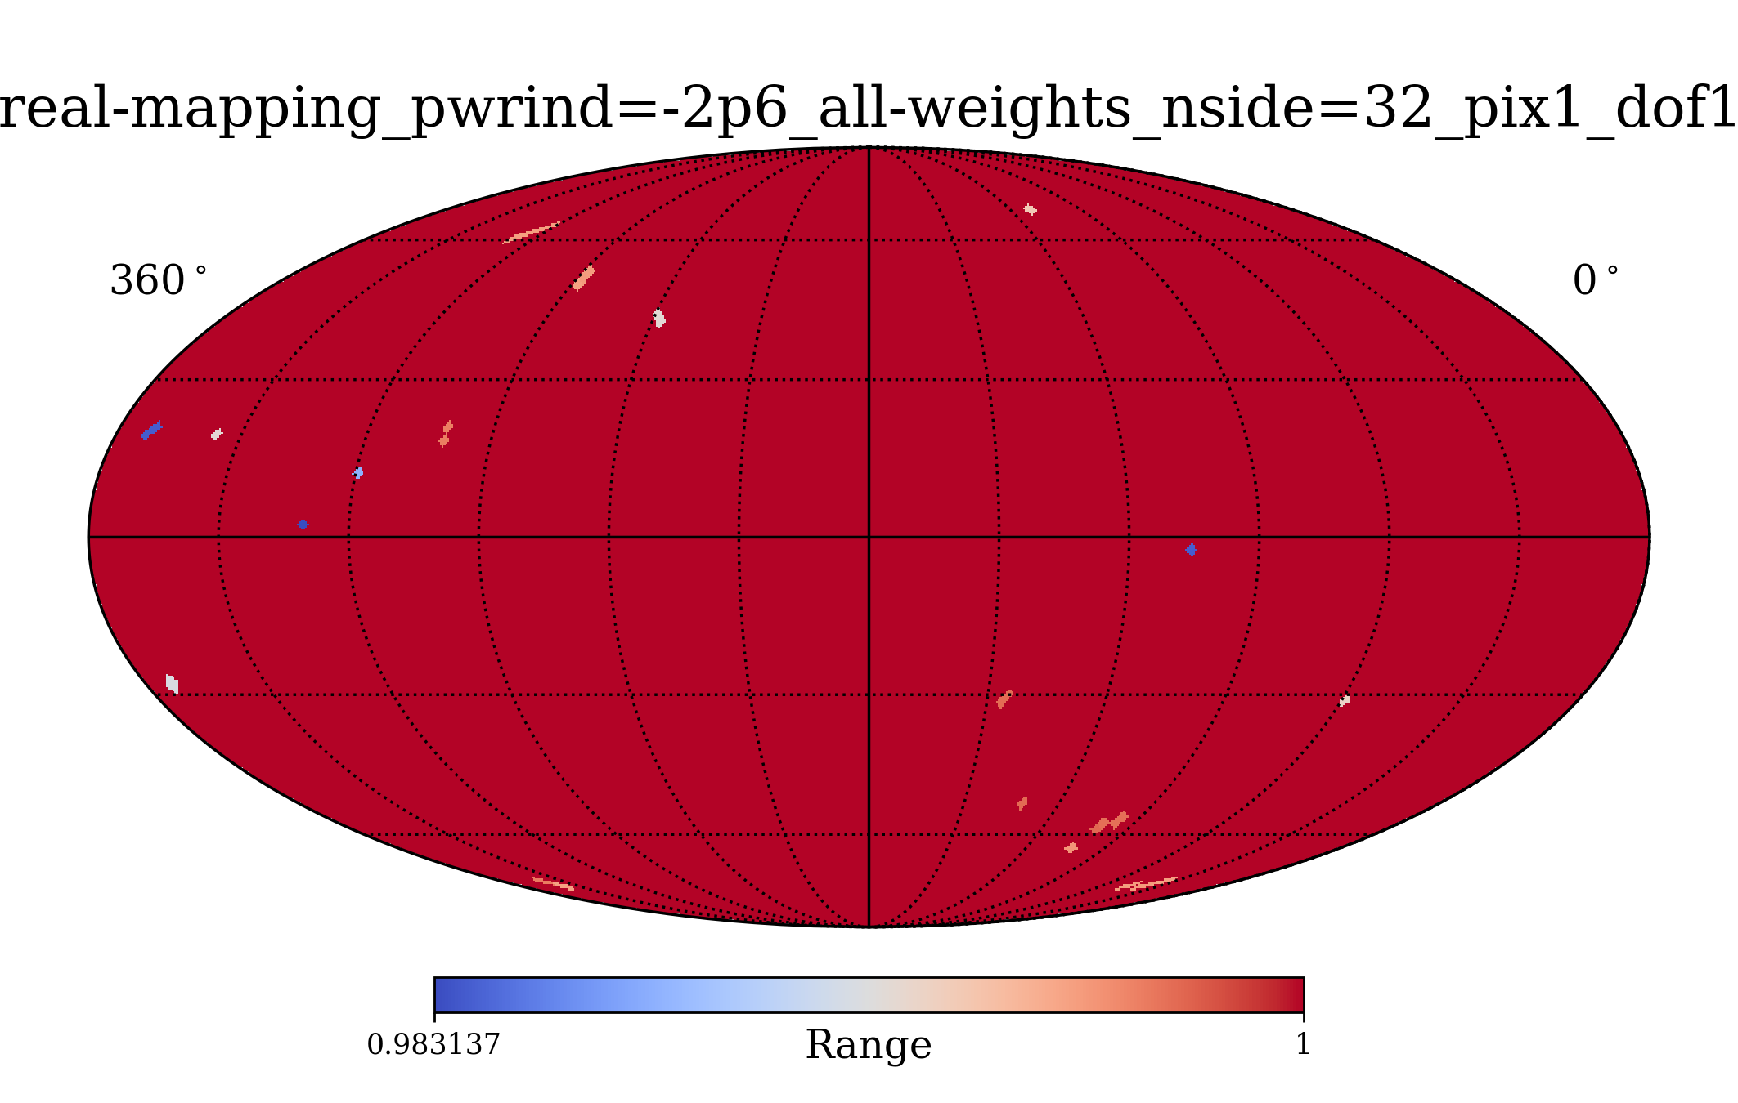
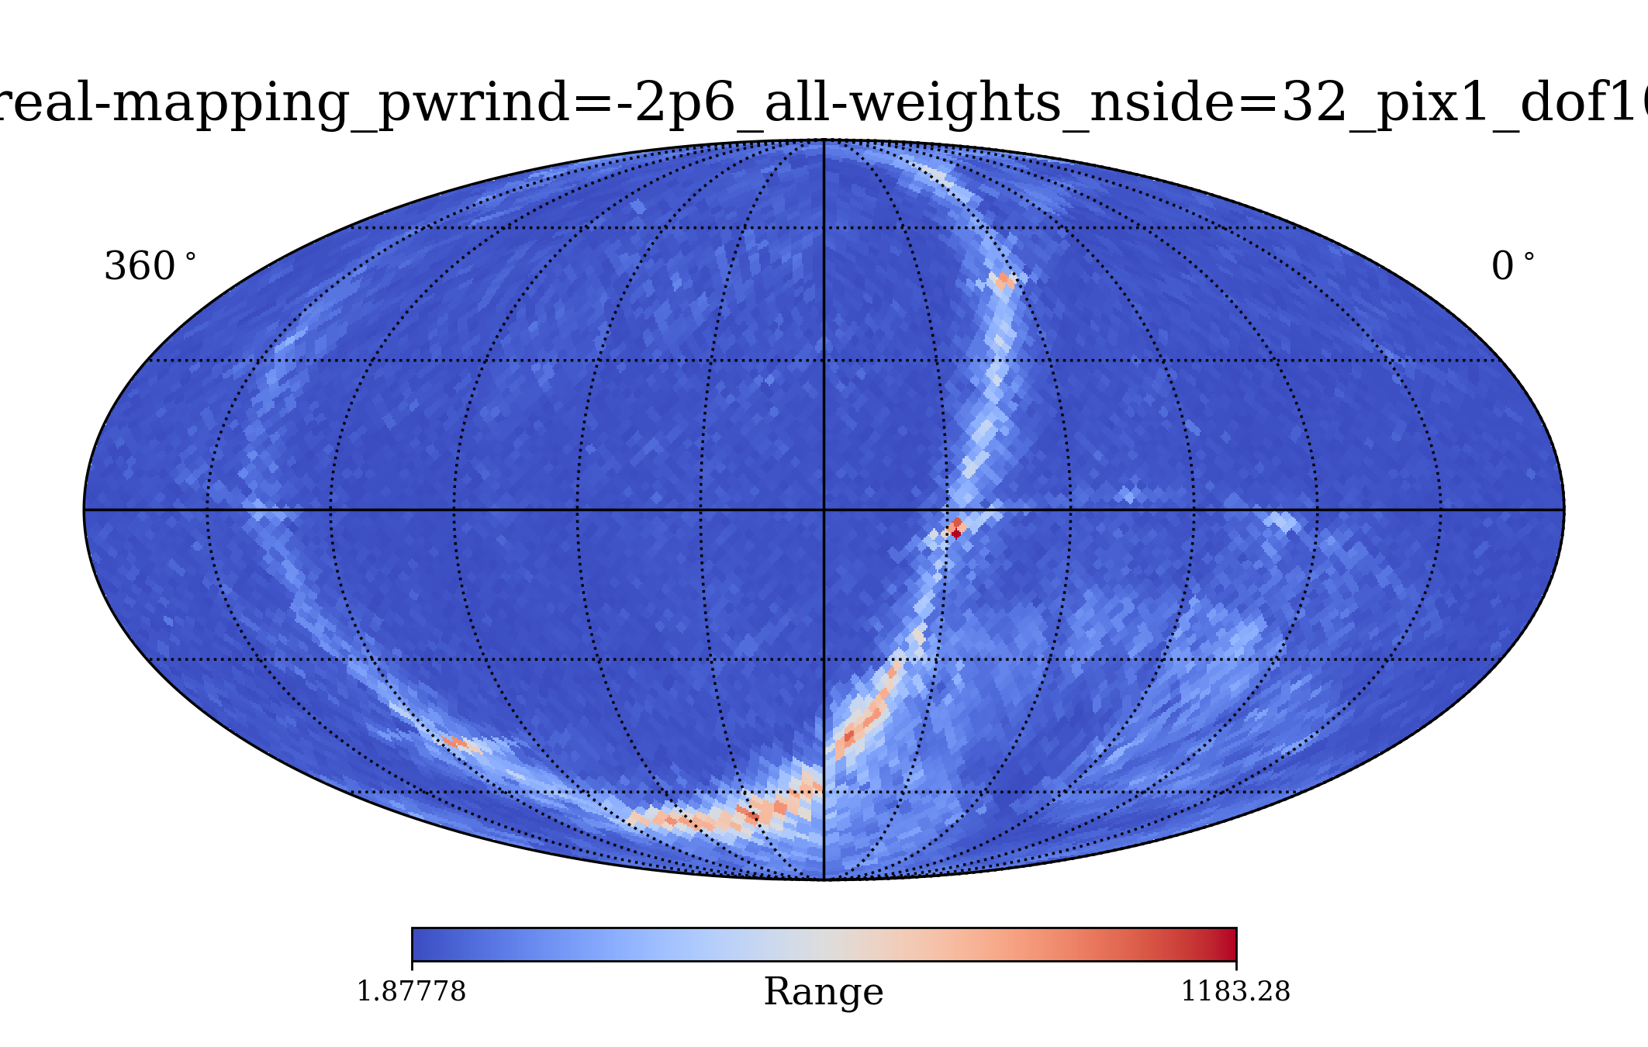
Results: without a gaussian distribution
DOF | 10
Physical index | -2,6
Obs weight (gaussian) | NA
Energy range (GeV) | [100, 100000]
Weights included | Directional, momentum, dipole
nside | 32

Slide 3
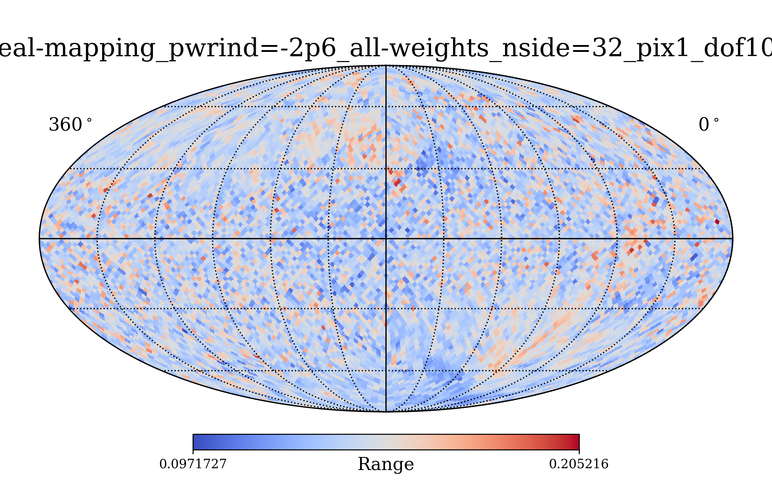
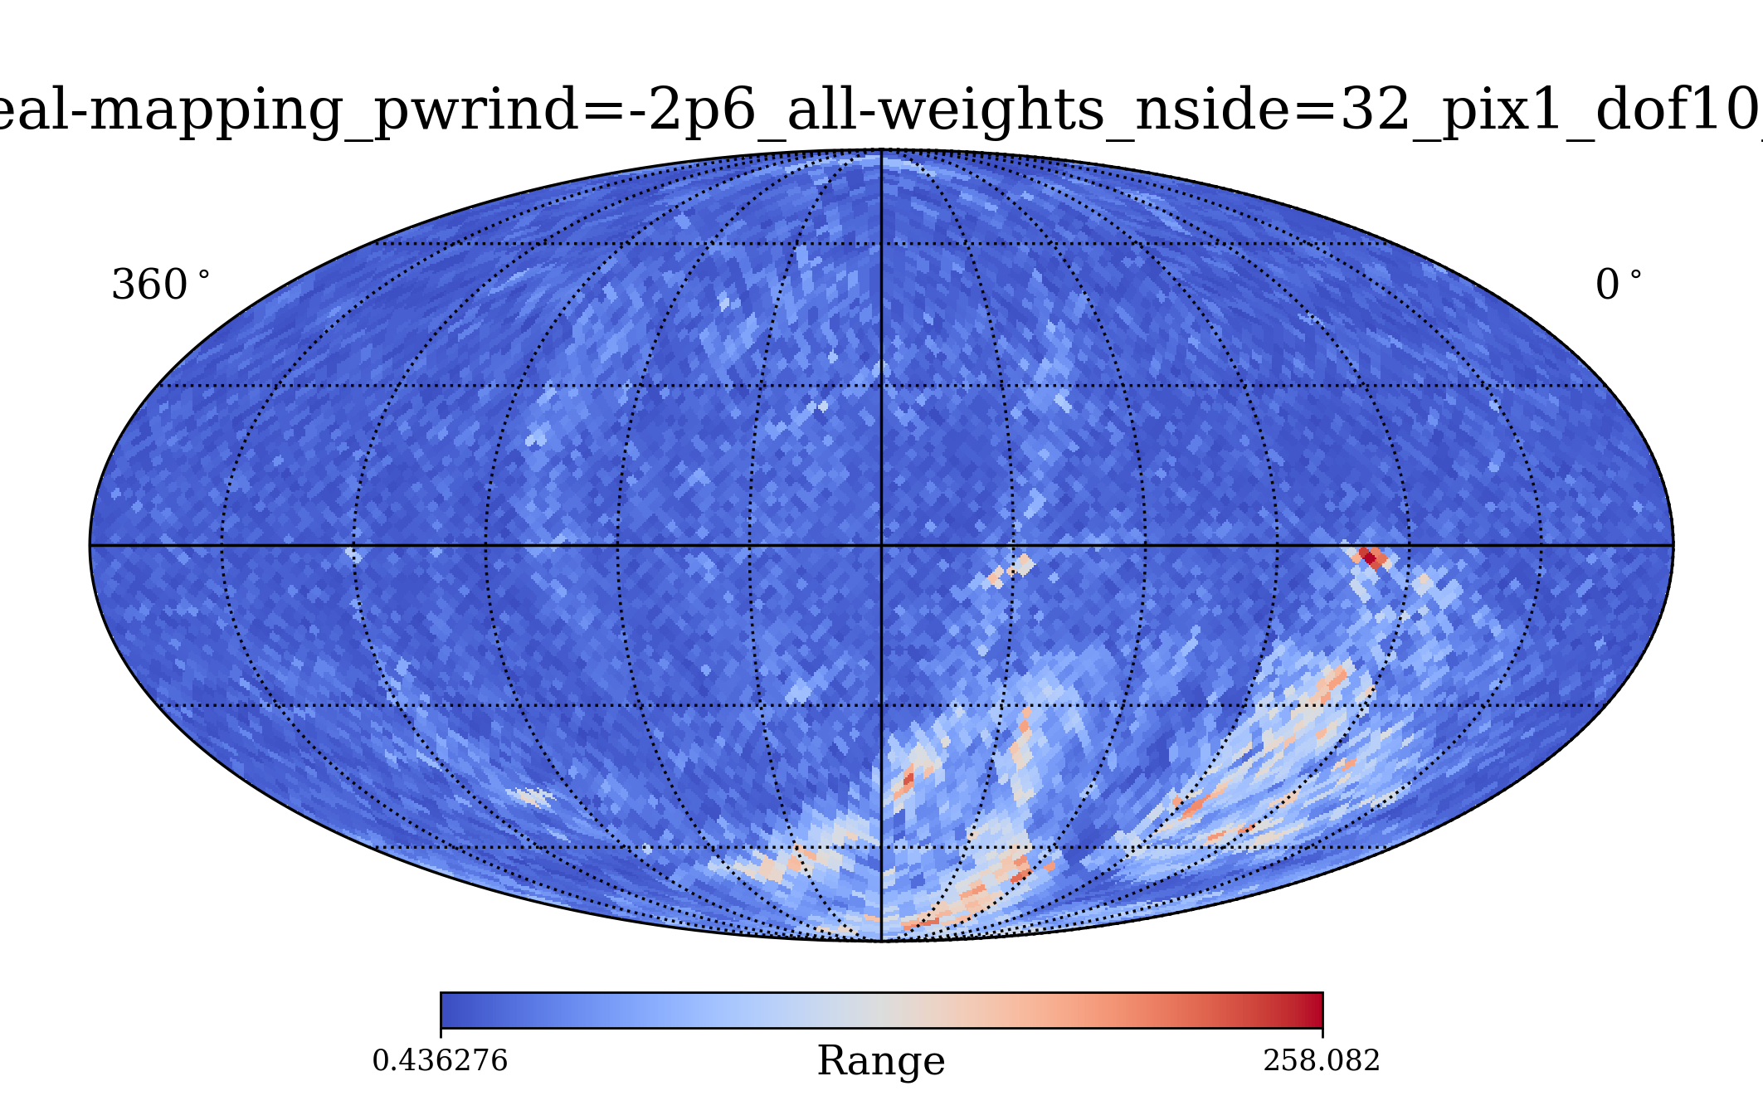
Results: gaussian distribution centered at 1TeV
DOF | 10
Physical index | -2,6
Obs weight (gaussian) | 1TeV
Energy range (GeV) | [100, 100000]
Weights included | Directional, momentum, dipole
nside | 32

Slide 4
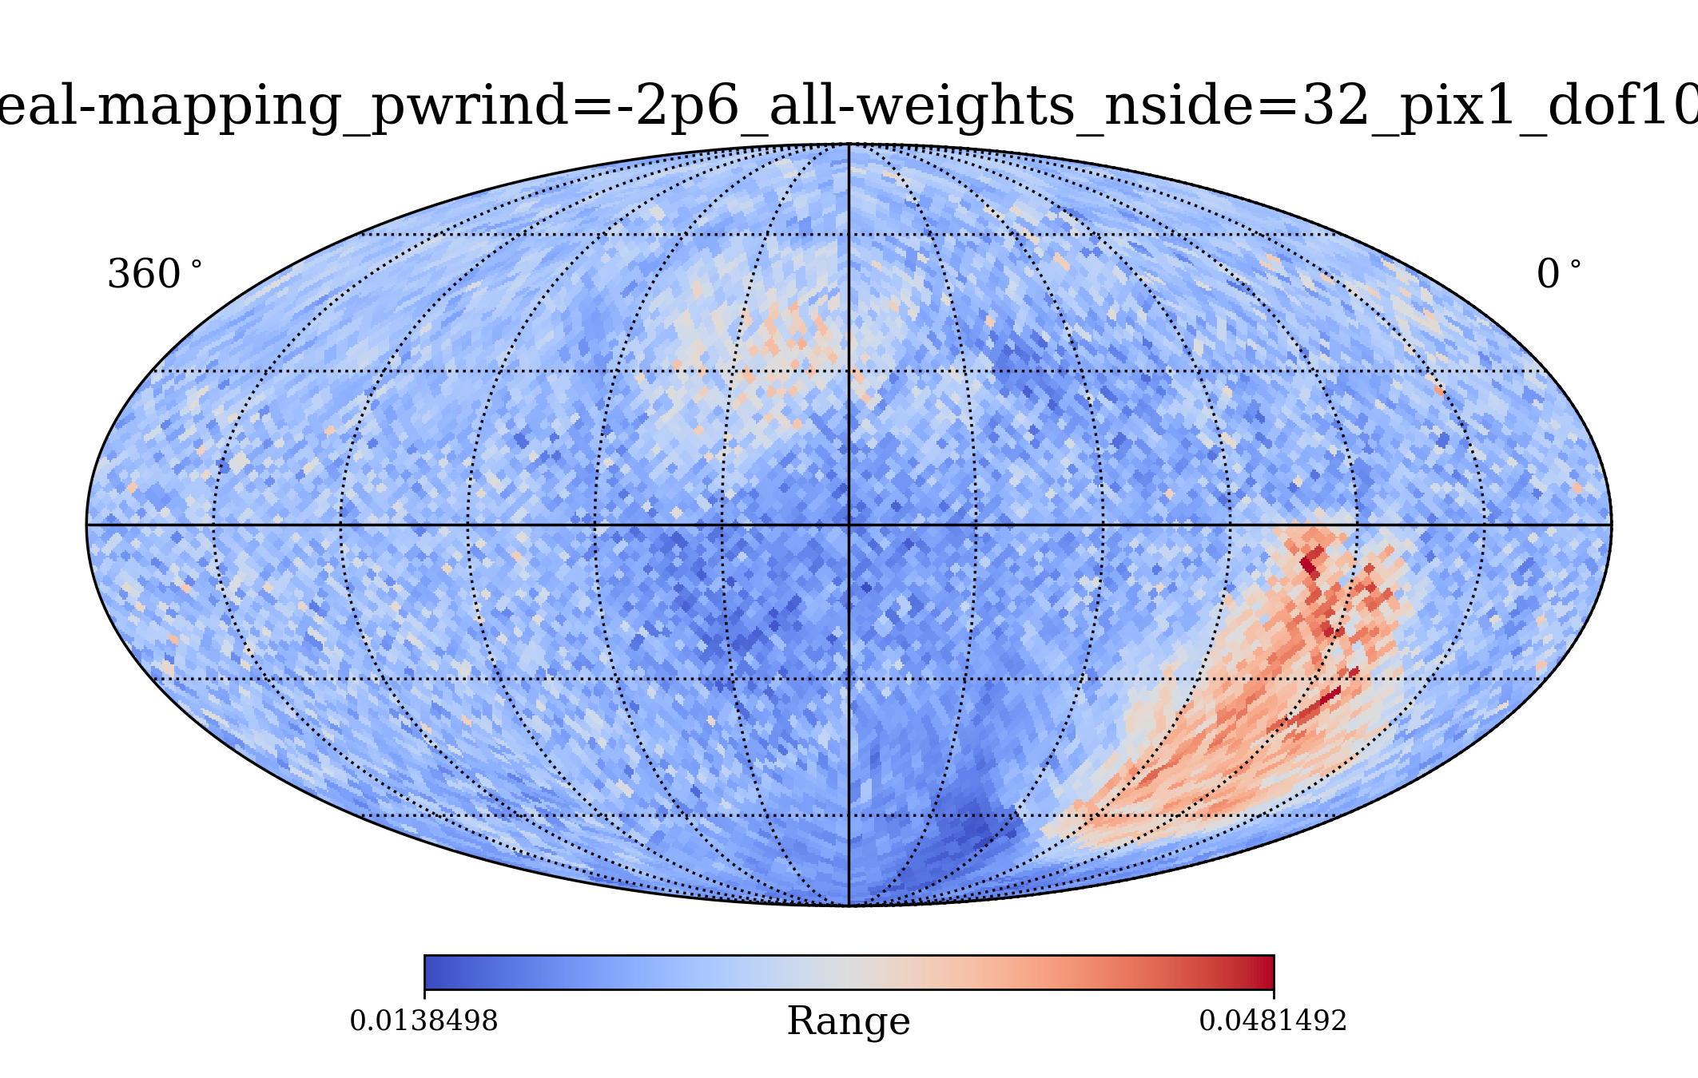
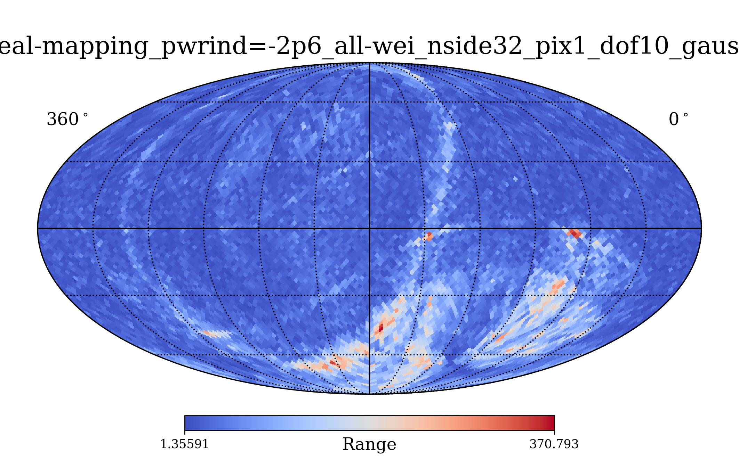
Results: gaussian distribution centered at 3TeV
DOF | 10
Physical index | -2,6
Obs weight (gaussian) | 3TeV
Energy range (GeV) | [100, 100000]
Weights included | Directional, momentum, dipole
nside | 32

Slide 5
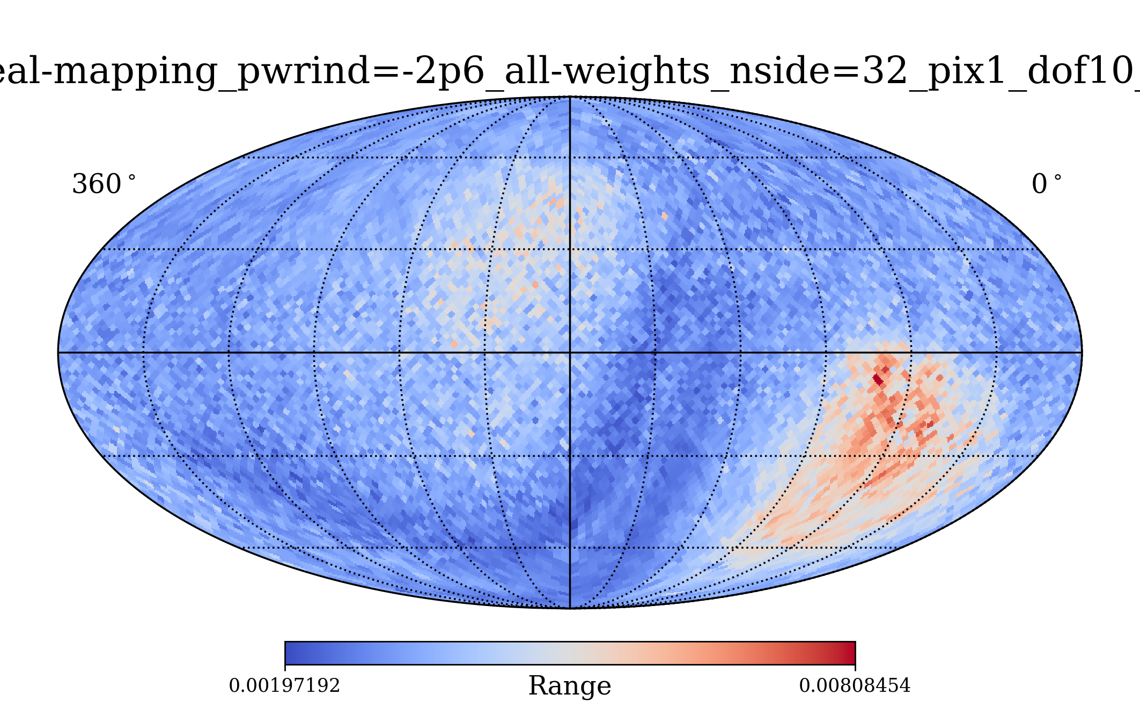
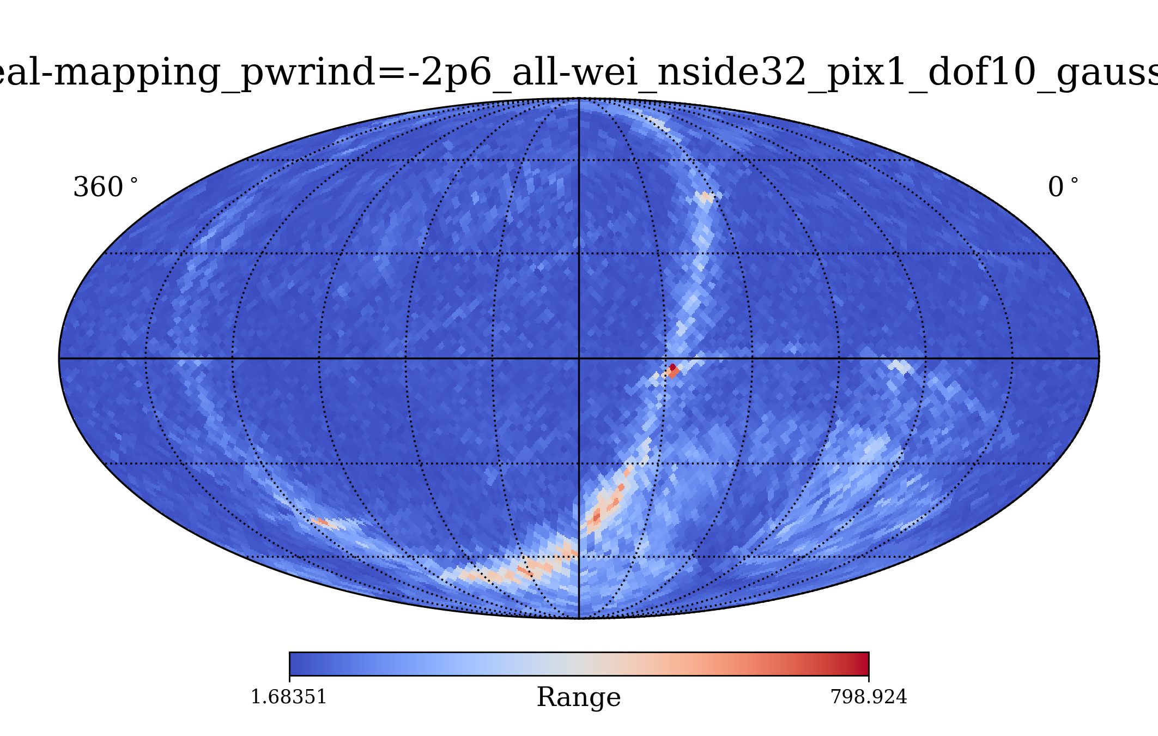
Results: gaussian distribution centered at 10TeV
DOF | 10
Physical index | -2,6
Obs weight (gaussian) | 10TeV
Energy range (GeV) | [100, 100000]
Weights included | Directional, momentum, dipole
nside | 32

Slide 6
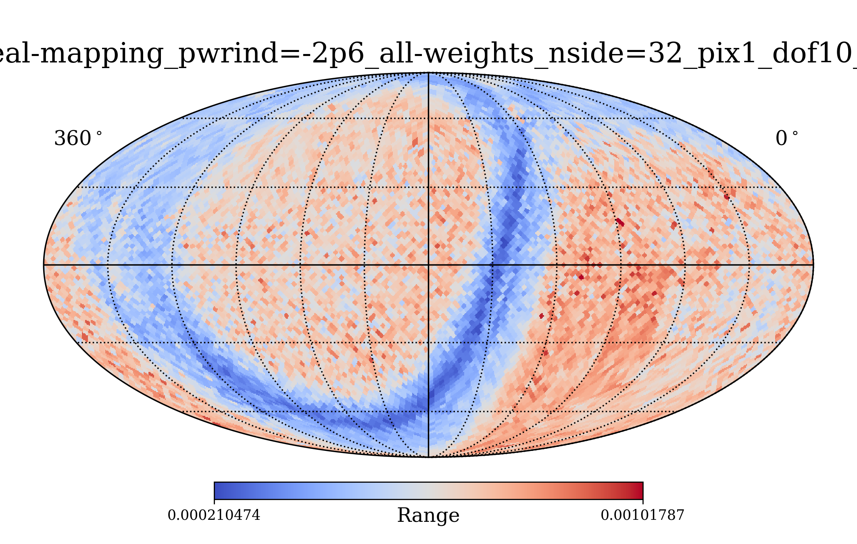
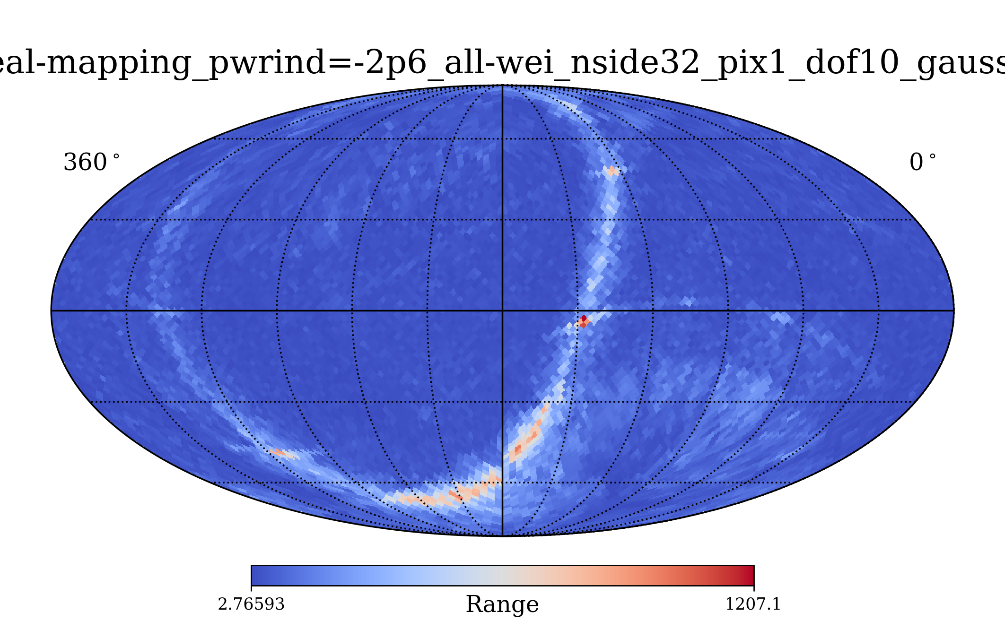
Results: gaussian distribution centered at 30TeV
DOF | 10
Physical index | -2,6
Obs weight (gaussian) | 30TeV
Energy range (GeV) | [100, 100000]
Weights included | Directional, momentum, dipole
nside | 32

Slide 7
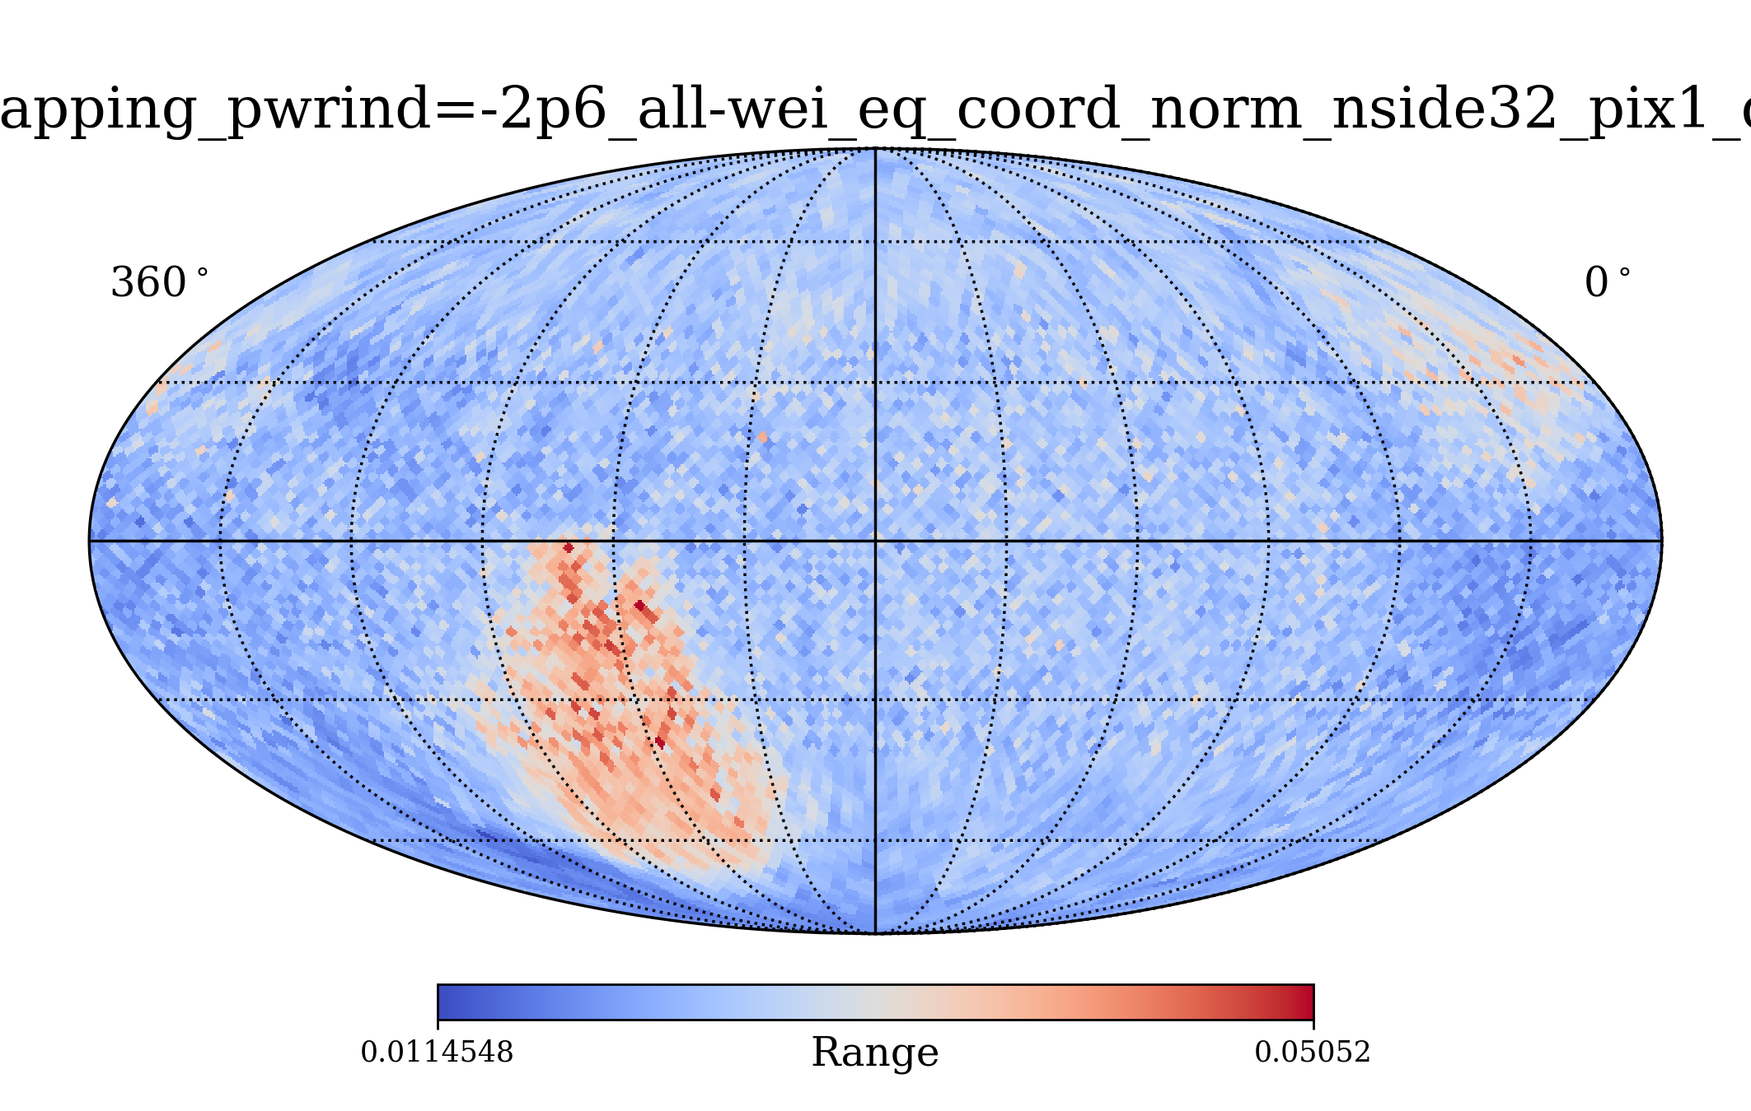
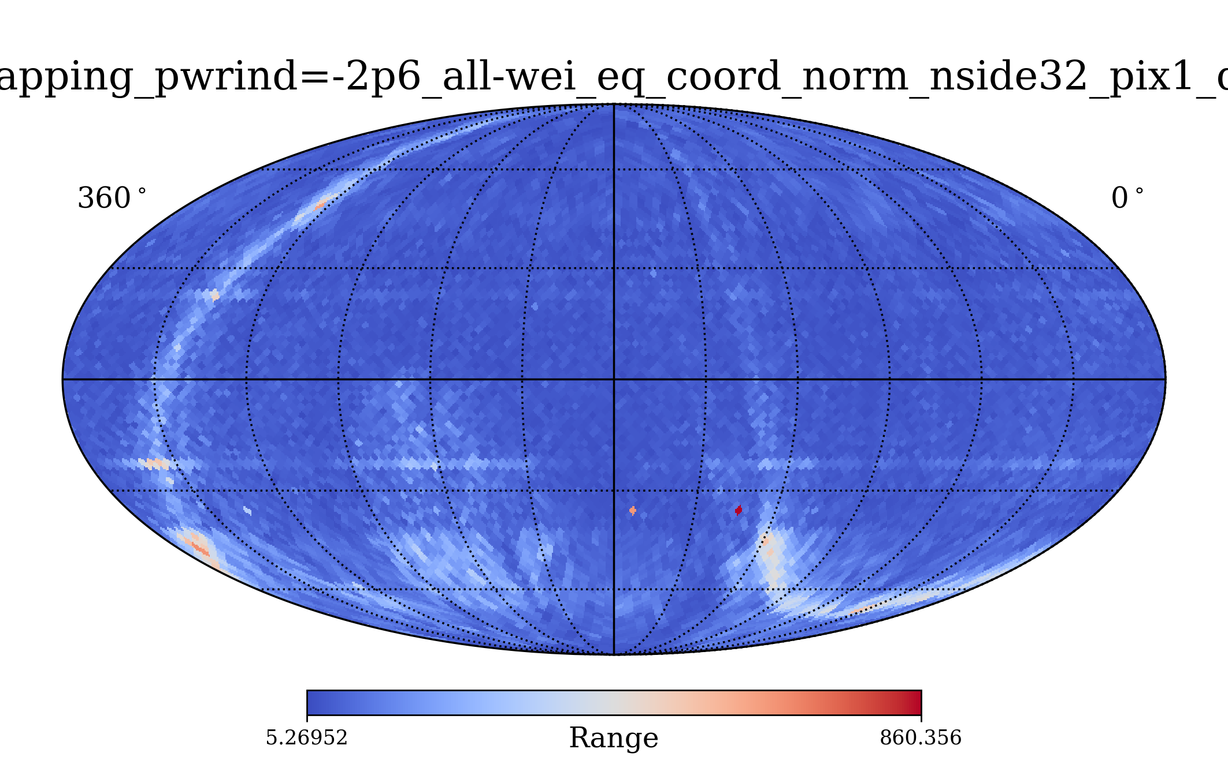
Results: gaussian distribution centered at 3TeV
Applying Momentum and Magnetic field rotation from Nicks → Ecliptic → Equatorial. Modification on function process_particle_data_equatorial_coord in data_methods_v2.
DOF | 20
Physical index | -2,6
Obs weight (gaussian) | 3TeV
Energy range (GeV) | [100, 100000]
Weights included | Directional, momentum, dipole
nside | 32

